Slide 1
Badhan Automated System Management

Slide 2
Process Design

Slide 3
Subsystems
Database Management
Search Management
Meeting Management
Notification Management
Automated Requisition Form Verification

Slide 4
1. Database Management

Slide 5
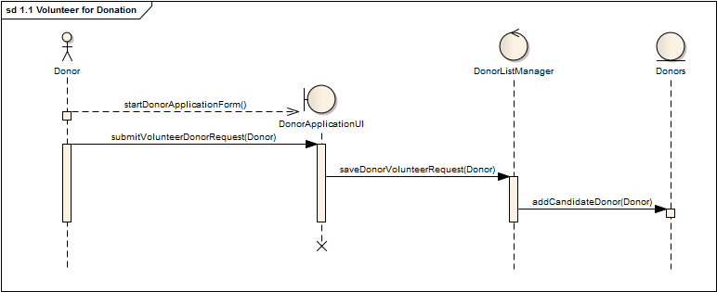
1.1 Volunteer for donation
Figure 1.1 – Sequence Diagram

Slide 6
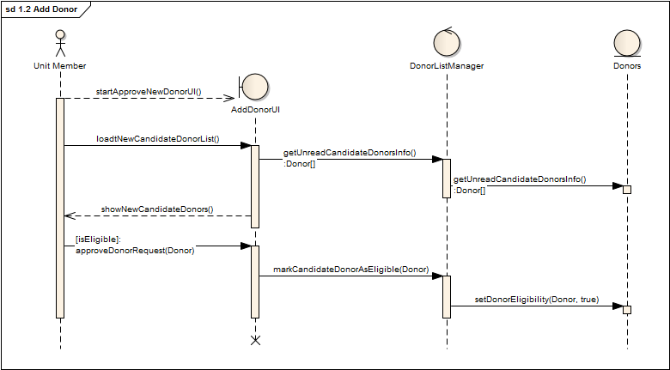
1.2 ADD DONOR
Figure 1.2 – Sequence Diagram

Slide 7
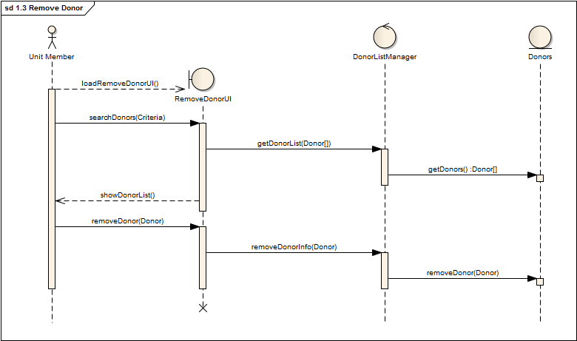
1.3 Remove donor
Figure 1.3 – Sequence Diagram

Slide 8
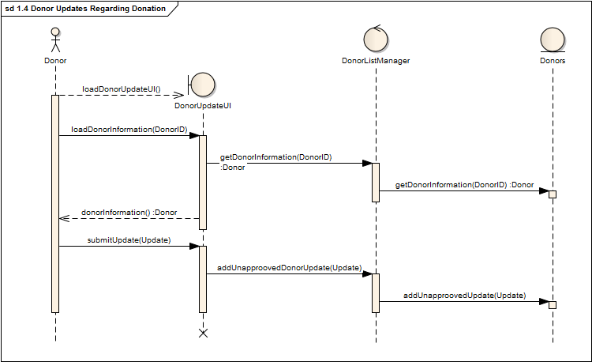
1.4 donor updates regarding donation
Figure 1.4 – Sequence Diagram

Slide 9
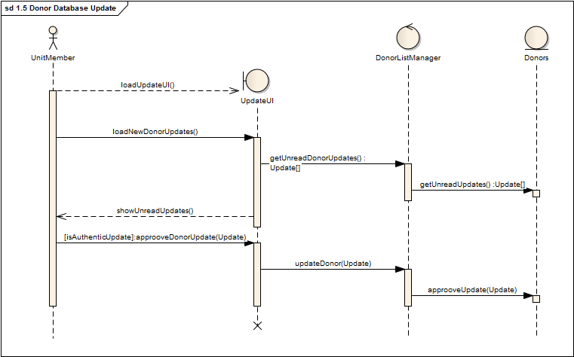
1.5 donor database update
Figure 1.5 – Sequence Diagram

Slide 10
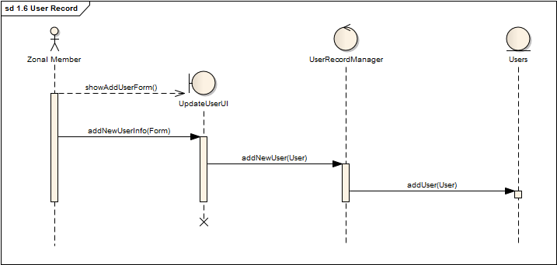
1.6 User record
Figure 1.6 – Sequence Diagram

Slide 11
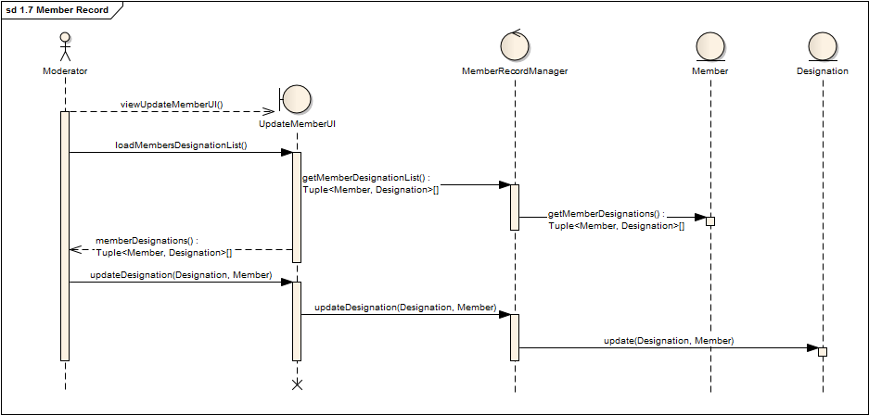
1.7 Member record
Figure 1.7 – Sequence Diagram

Slide 12
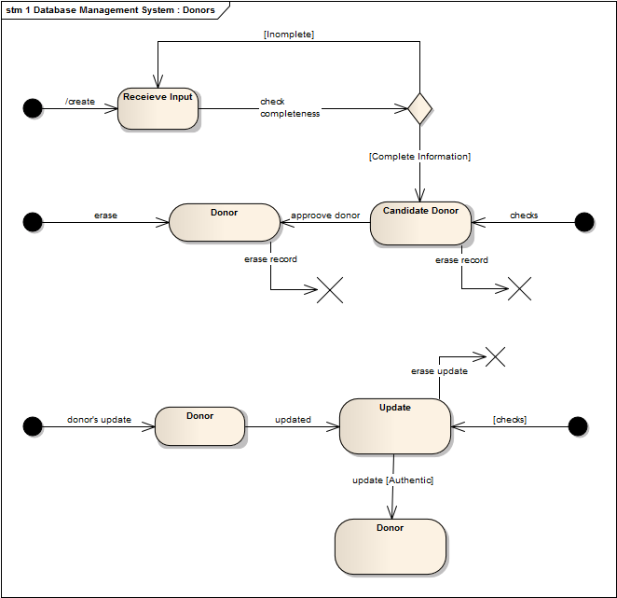
State Diagram : Donors

Slide 13
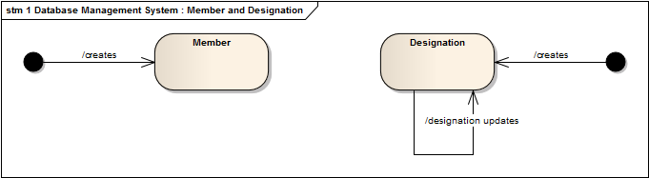
State Diagram : Member and Designation

Slide 14
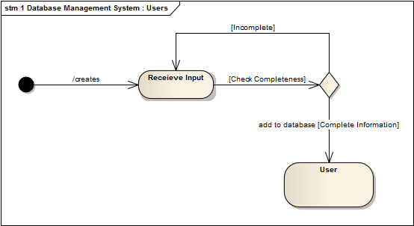
State Diagram : Users

Slide 15
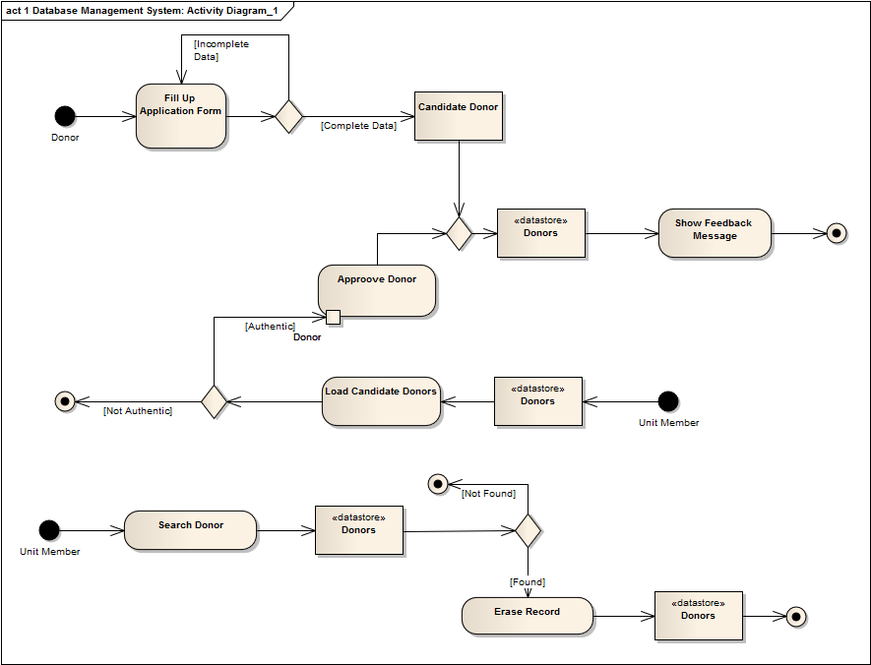
Activity Diagram

Slide 16
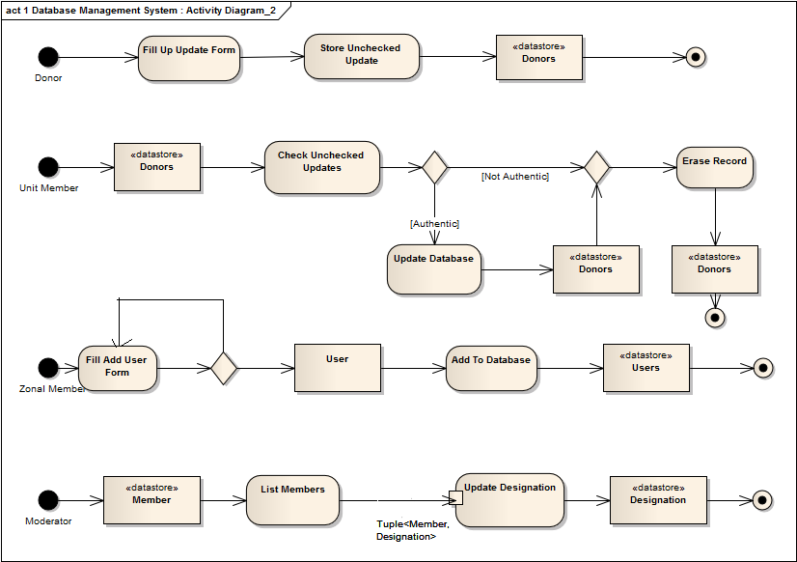
Activity Diagram Continued…

Slide 17
Q&A
Any Questions?

Slide 18
Thank You

Slide 19
2. Search Management

Slide 20
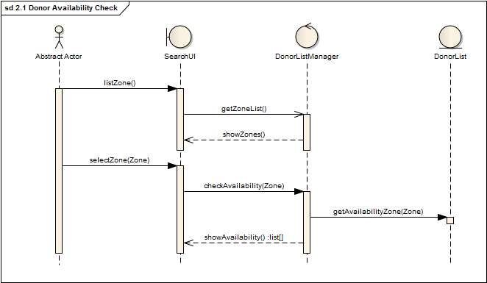
2.1 donor availability check
Figure 2.1 – Sequence Diagram

Slide 21
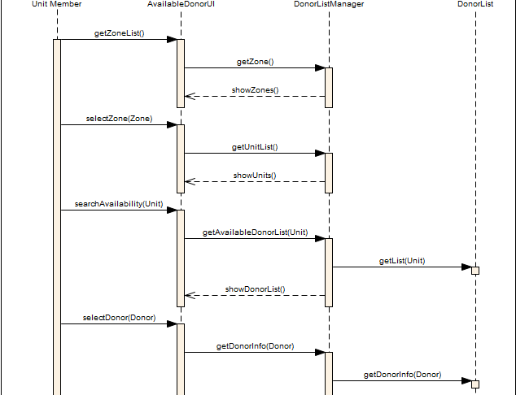
2.2 unit donor availability list – Sequence Diagram

Slide 22
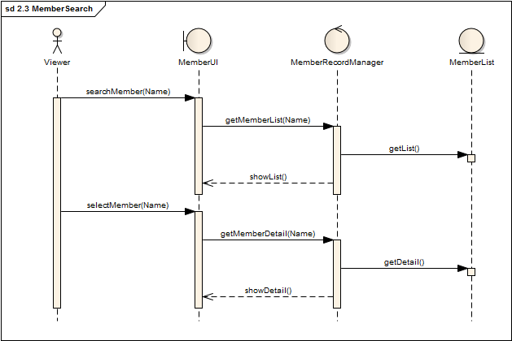
2.3 member search
Figure 2.3 – Sequence Diagram

Slide 23
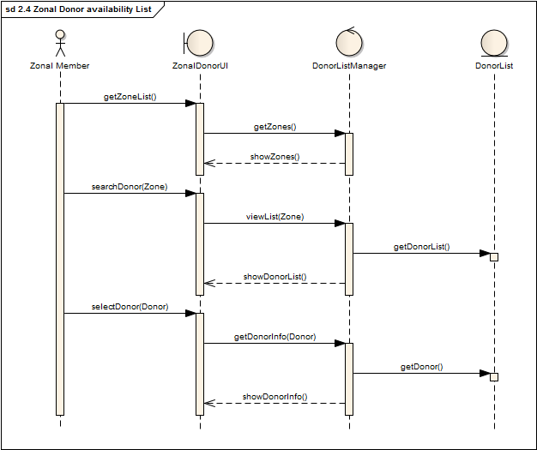
2.4 Zonal Donor Availability list – Sequence Diagram

Slide 24
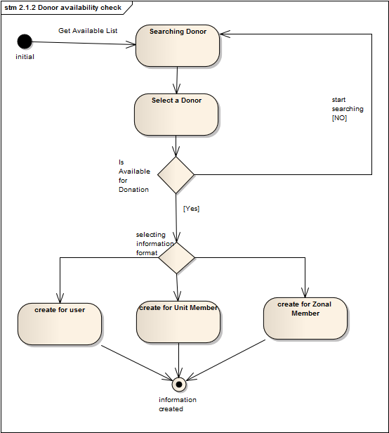
State Diagram : Donor

Slide 25
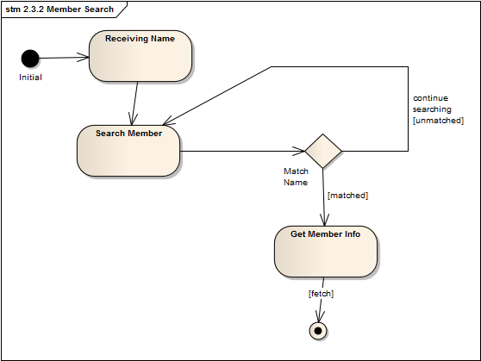
State Diagram : Member

Slide 26
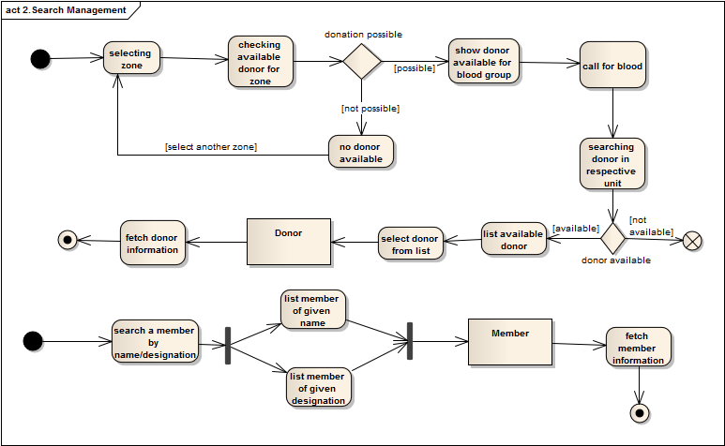
Activity Diagram

Slide 27
3. Meeting Management

Slide 28
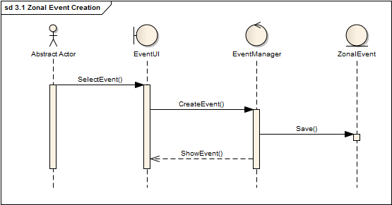
3.1 zonal event creation
Figure 3.1 – Sequence Diagram

Slide 29
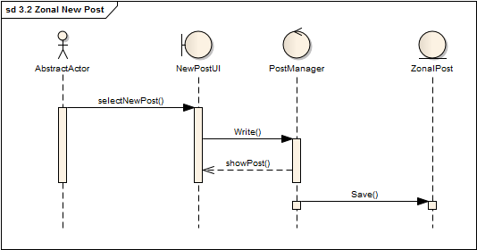
3.2 zonal new post
Figure 3.2 – Sequence Diagram

Slide 30
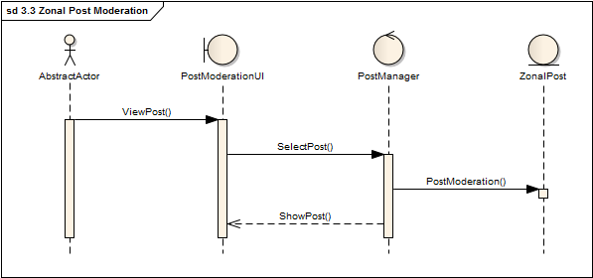
3.3 zonal post moderation
Figure 3.3 – Sequence Diagram

Slide 31
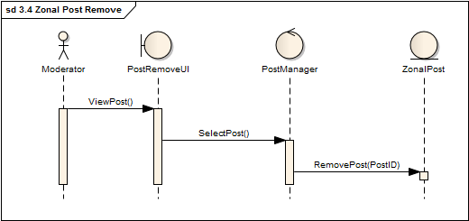
3.4 zonal post remove
Figure 3.4 – Sequence Diagram

Slide 32
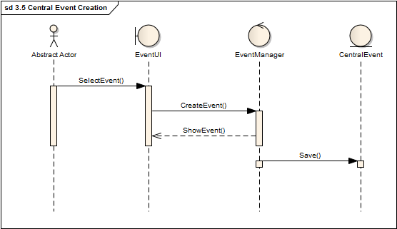
3.5 central event creation
Figure 3.5 – Sequence Diagram

Slide 33
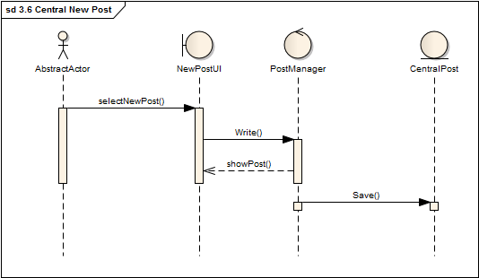
3.6 central new post
Figure 3.6 – Sequence Diagram

Slide 34
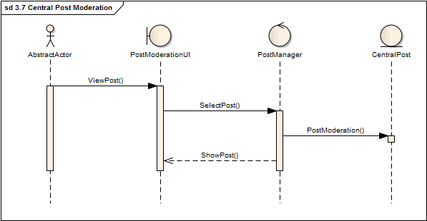
3.7 central post moderation
Figure 3.7 – Sequence Diagram

Slide 35
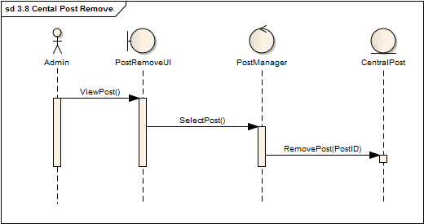
3.8 central post remove
Figure 3.8.1 – Sequence Diagram

Slide 36
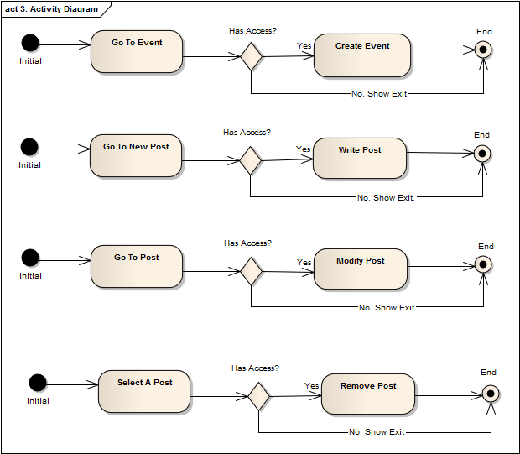
Activity Diagram

Slide 37
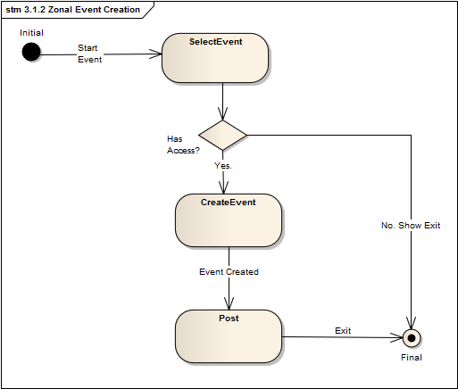
State Diagram : Event

Slide 38
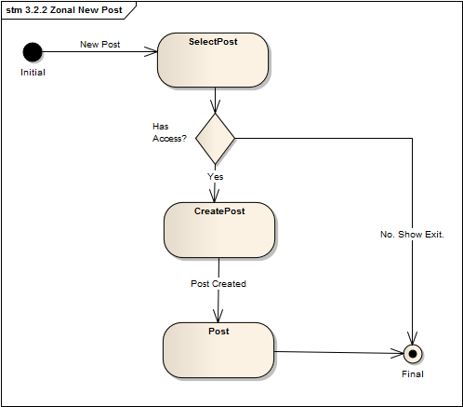
State Diagram : Post

Slide 39
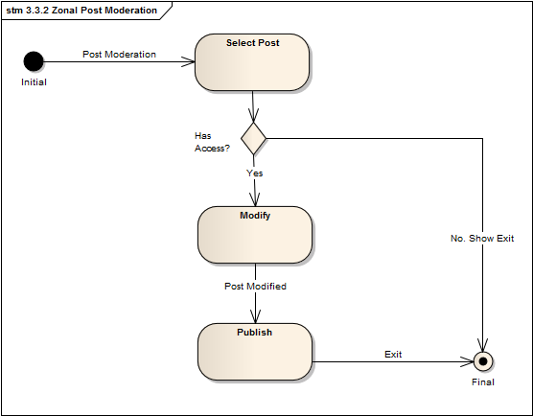
State Diagram : Post

Slide 40
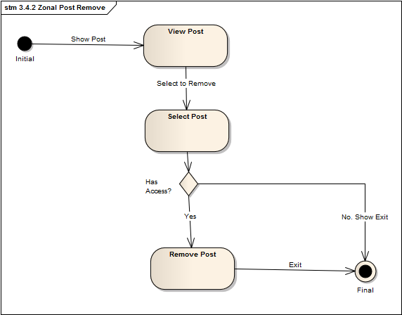
State Diagram : Post

Slide 41
4. Notification Management

Slide 42
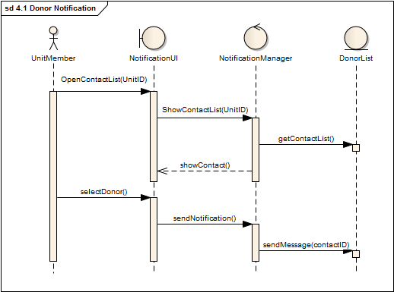
4.1 donor notification
Figure 4.1 – Sequence Diagram

Slide 43
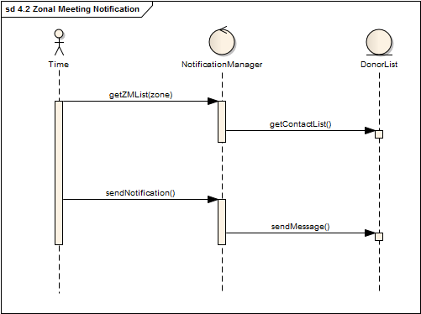
4.2 Zonal meeting notification
Figure 4.2 – Sequence Diagram

Slide 44
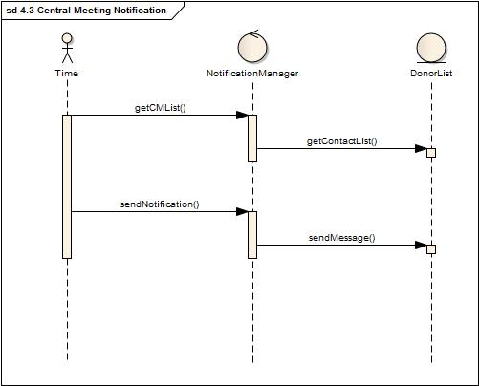
4.3 central meeting notification
Figure 4.3 – Sequence Diagram

Slide 45
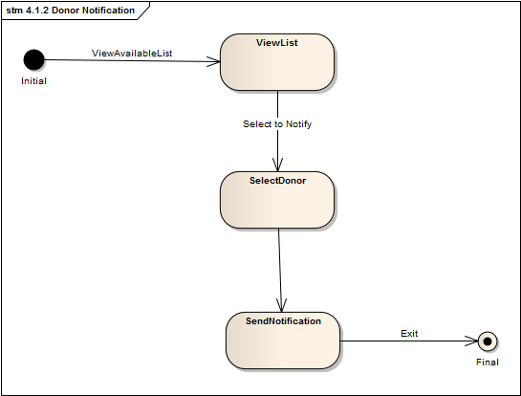
State Diagram : Donor

Slide 46
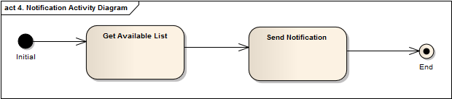
Activity Diagram

Slide 47
5. Automated Requisition Form Verification

Slide 48
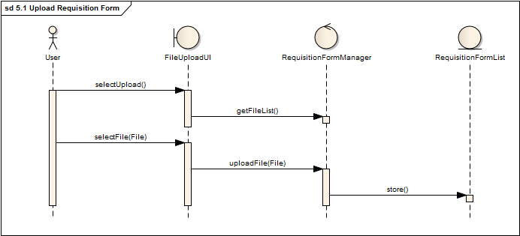
5.1 upload requisition form
Figure 5.1 – Sequence Diagram

Slide 49
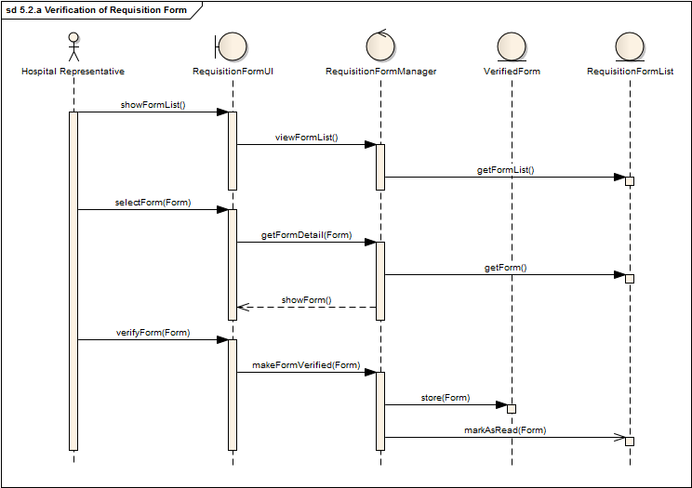
5.2 Verification of Requisition Form
Figure 5.2(A) – Sequence Diagram

Slide 50
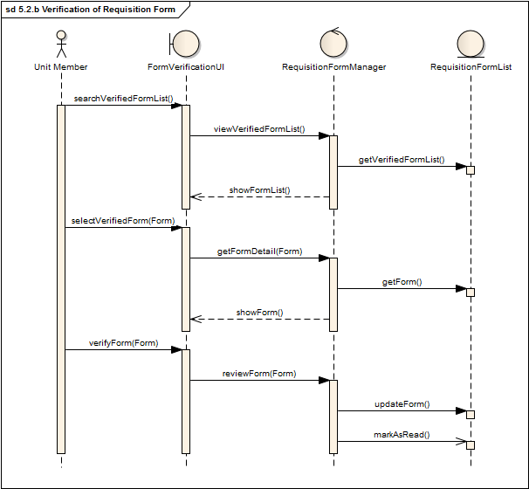
5.2(b) Verification of requisition form
5.2(B) – Sequence Diagram

Slide 51
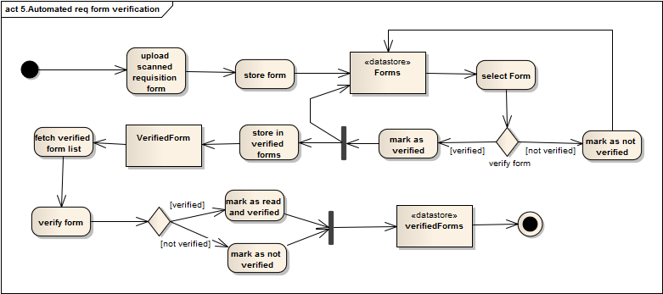
State Diagram : Requisition Form

Slide 52
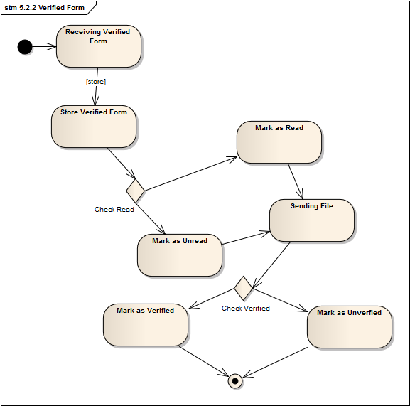
State Diagram : Requisition Form

Slide 53
Activity Diagram

Slide 54
END

